Slide 1
Analyzing Educational Loan Application Data

Slide 2
Problem Statement
A FinTech company specialize in lending loans to customers. They are interested in lending money to one lakh student as an educational loan without considering credit history. Moreover, they also want to understand the patterns in these one lakh clients’ difficulty in paying installments. These features can help in identifying such loans applications and can lead to denying the loan, reducing the amount of loan, lending (at a higher interest rate) and, thereby improving there portfolio and risk assessment .

Slide 3
Abstract
This is the first step towards the Exploratory Data Analysis. This process named as data exploration helps identify patterns, trends, and anomalies, providing insights into borrower behavior and loan performance. Key metrics like average loan amounts, distribution of interest rates, and repayment timelines are examined. Visualizations such as histograms, bar plots, and scatter plots are used to illustrate these findings. Understanding these factors aids in risk assessment, policy formulation, and improving loan offerings to better serve students' financial needs.

Slide 4
Exploring the dataset
Understand the data-data dimensions
How to handle those outliers if present
How to handle missing values in the data
Understand the missing values
Identify high and low cardinal data
What are the values each categorical variable have
Are the data types of each column intuitively right?
Check for the outliers in numerical variables
How to handle high cardinal data

Slide 5
Understanding data dimension
The dimensions refer to the number of rows and columns in the dataset, which can be easily determined using the ‘shape’ attribute in pandas. Rows typically represent individual records or observations, while columns represent different features or variables. Analyzing the dimensions helps in assessing the dataset's scale and complexity, guiding further analysis steps.
Here is the dimension of the data as 101710 rows and 33 columns

Slide 6
Understand the missing values
Column name | Frequency | Missing Value | Way to resolve
Sector | 740 | “-” | Replace with nan value and then fill with mean value .
cibilscore | 29548 | “000-1” | Replace with nan value and then fill with mean value .
Permanent state | 145 | Puduchery_x000D_n\ Andaman and Nicobar along with Andaman and Nicobar island | Drop this column. Replace one with another.

Slide 7
Identify high and low cardinal data
Column Name | Attribute Name | Frequency
Profession | Salaried | 74774
Current status | EMI running | 101704
Current state | Maharastra | 20592
Permanent state | Maharastra | 20535
Lender name | ABFL | 40922
Work Experience | More than 2 year | 75491
Loan type | Certification Loan | 82921
sector | Sector | 58758
Company name | Student | 2383

Slide 8
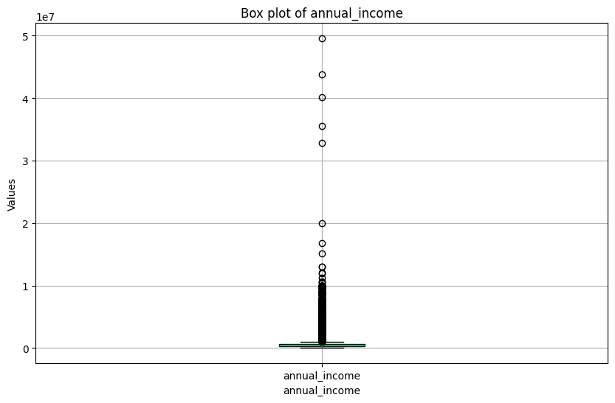
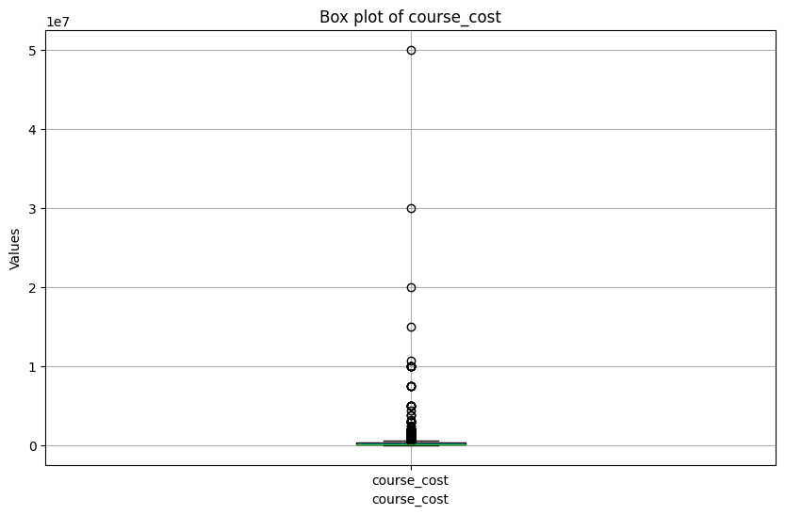
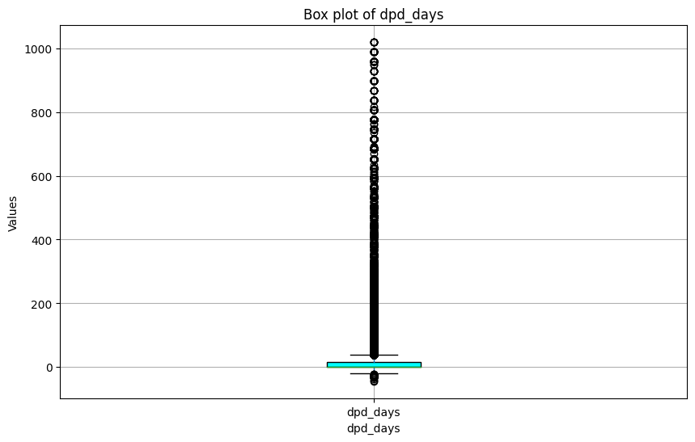
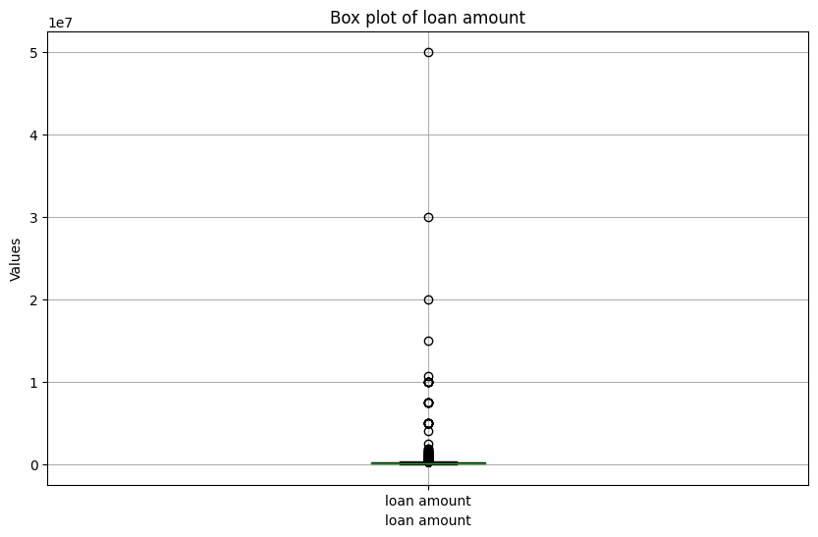
Outliers in numerical variable
Annual income has 10467 outliers
Loan amount has 2232 outliers.
Course cost has 1273 outliers.
Dpd days 17047 outliers.
Tenure has 2054 outliers.
Emi amount has 7502 outliers.
Interest rate has 10544 outliers.

Slide 9
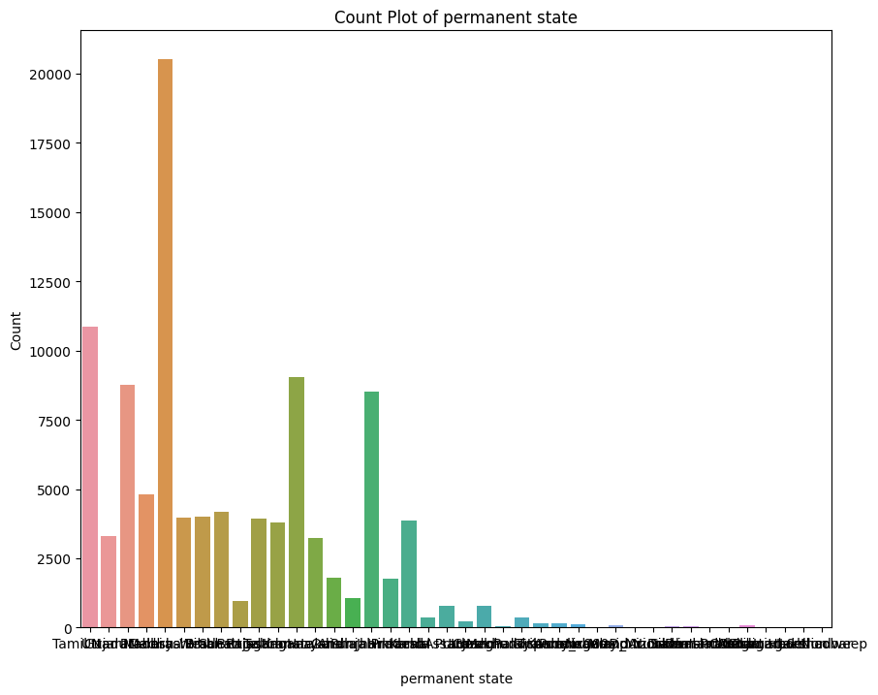
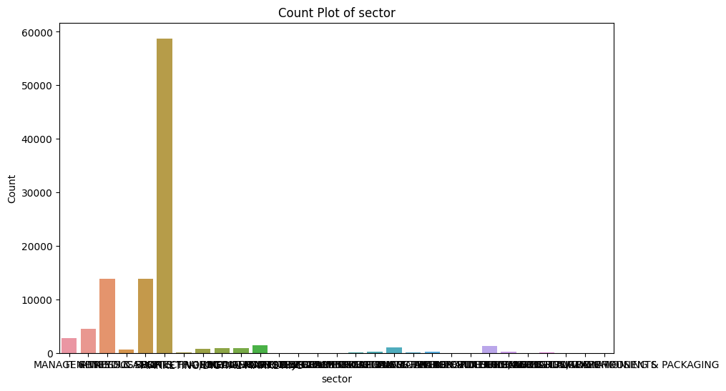
How to handle the outliers
As the data present here is highly skewed data we can use -
Log Transformation: Apply a logarithmic transformation to reduce the impact of outliers.
Square Root Transformation: Apply a square root transformation for positive data.
And can try to normalize the data.

Slide 10
How to handle missing values
Use dropna() to remove rows or columns with missing values.
Using pandas replace the placeholders with Nan and then fill them with mean value.

Slide 11
How to handle high cardinal values
The best suited technique to handle high cardinal values for this data is One-Hot Encoding with Threshold: One-hot encode only the most frequent categories.

